Slide 1
Welcome to our webinar!
This webinar starts in 5 minutes - please stay tuned
This webinar will be recorded
You will get the slides, recording and SQL snippets
During the webinar, you may ask questions using the Q&A button - you may ask questions anonymously
You can hop on and off on all the sessions
Day 1 | 15:00 - 16:30 Applying DV Community Solutions 16:30 - 16:45 Break 16:45 - 18:15 Advanced SQL problems and solutions

Slide 2
DATA VIRTUALITY
Topic: Advanced SQL problems and solutions

Slide 3
Agenda
Wide variety of problems and topics.
Code
All the code used in the presentation is available in Data Virtuality’s GitHub account.

Slide 4
Tally table or numbers table

Slide 5
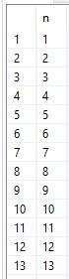
What is a numbers table or tally table?
Starts at 1

Slide 6
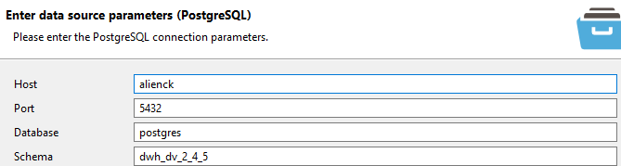
Numbers table or tally table
Create the Numbers table in DWH
call "master_class_2021_adv_sql._InitNumberTable"();;
call "dwh.native"("request" => 'ALTER TABLE "dwh_dv_2_4_5"."Numbers" ADD PRIMARY KEY (n);');
dwh_dv_2_4_5 is the name of my schema in my DWH

Slide 7
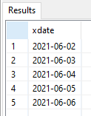
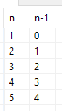
Using Numbers table with dates
select * from (call "master_class_2021_adv_sql.dateaxis"(
"start_date" => '2021-06-02',
"num_days" => 5
)) as a;;
create virtual procedure master_class_2021_adv_sql.dateaxis(
IN start_date date,
IN num_days integer
)
returns (
xdate date
)
as
begin
select
cast(timestampadd(SQL_TSI_DAY, n.n -1, start_date) as date)
from
"dwh.Numbers" n
where n.n <= num_days;
end;;
select n, n-1 as "n-1"
from "dwh.Numbers" n
where n.n <= 5

Slide 8
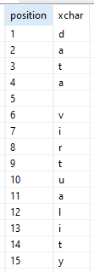
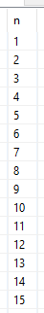
Using Numbers table with text
select * from (call "master_class_2021_adv_sql.split_text"(
"str" => 'data virtuality'
)) as a;;
alter virtual procedure master_class_2021_adv_sql.split_text (
IN str string
) returns (
position long
,xchar string (1)
) as
begin
select
n.n
,SUBSTRING (str, cast (n.n as integer), 1)
from
"dwh.Numbers" n
where
n.n <= length (str) ;
end;;
select n
from "dwh.Numbers" n
where n.n <= length('data virtuality');;

Slide 9
Data gaps and overlaps

Slide 10
Data gaps and overlaps: Create our sample invoice data
call "master_class_2021_adv_sql._InitInvoices"();;
SELECT "invoice_num", "license_start", "license_end" FROM "dwh.tblInvoices";;
row | invoice_num | license_start | license_end
1 | 1 | 2020-06-01 | 2020-07-01
2 | 2 | 2020-07-01 | 2020-07-31
3 | 3 | 2020-08-01 | 2020-08-31
4 | 6 | 2020-09-01 | 2020-09-15
5 | 7 | 2020-10-01 | 2020-10-31
6 | 8 | 2020-10-15 | 2020-11-30

Slide 11
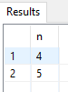
Data gaps and overlaps: find missing invoices
SELECT "invoice_num", "license_start", "license_end" FROM "dwh.tblInvoices";;
row | invoice_num | license_start | license_end
1 | 1 | 2020-06-01 | 2020-07-01
2 | 2 | 2020-07-01 | 2020-07-31
3 | 3 | 2020-08-01 | 2020-08-31
4 | 6 | 2020-09-01 | 2020-09-15
5 | 7 | 2020-10-01 | 2020-10-31
6 | 8 | 2020-10-15 | 2020-11-30
select n.n from "dwh.Numbers" n where n.n between 1 and 8
except
SELECT "invoice_num" FROM "dwh.tblInvoices"
order by 1
;;

Slide 12
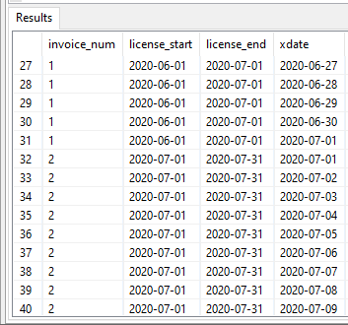
Data gaps and overlaps: expand all dates
SELECT "invoice_num", "license_start", "license_end" FROM "dwh.tblInvoices";;
row | invoice_num | license_start | license_end
1 | 1 | 2020-06-01 | 2020-07-01
2 | 2 | 2020-07-01 | 2020-07-31
3 | 3 | 2020-08-01 | 2020-08-31
4 | 6 | 2020-09-01 | 2020-09-15
5 | 7 | 2020-10-01 | 2020-10-31
6 | 8 | 2020-10-15 | 2020-11-30
create view master_class_2021_adv_sql.License_dates as
SELECT i.invoice_num, i.license_start, i.license_end, d.xdate
FROM
"dwh.tblInvoices" as i
join "master_class_2021_adv_sql.dateaxis_start_end"(
"startdate" => '2020-06-01',
"enddate" => '2020-11-30'
) as d
on d.xdate between i.license_start and i.license_end
;;

Slide 13
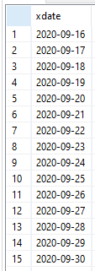
Data gaps and overlaps: find gap in date range
SELECT "invoice_num", "license_start", "license_end" FROM "dwh.tblInvoices";;
row | invoice_num | license_start | license_end
1 | 1 | 2020-06-01 | 2020-07-01
2 | 2 | 2020-07-01 | 2020-07-31
3 | 3 | 2020-08-01 | 2020-08-31
4 | 6 | 2020-09-01 | 2020-09-15
5 | 7 | 2020-10-01 | 2020-10-31
6 | 8 | 2020-10-15 | 2020-11-30
create view master_class_2021_adv_sql.License_missing_dates as
select
d.xdate
from
"master_class_2021_adv_sql.dateaxis_start_end"(
"startdate" => '2020-06-01',
"enddate" => '2020-11-30'
) as d
except
select
d.xdate
FROM
"dwh.tblInvoices" as i
join "master_class_2021_adv_sql.dateaxis_start_end"(
"startdate" => '2020-06-01',
"enddate" => '2020-11-30'
) as d
on d.xdate between i.license_start and i.license_end
;;

Slide 14
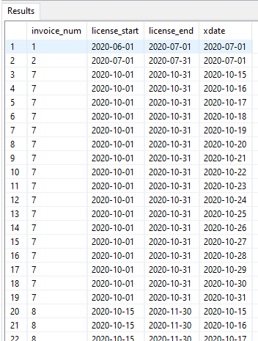
Data gaps and overlaps: find overlapping dates
create view master_class_2021_adv_sql.License_overlapping_dates_v2 as
with cteAllDates as (
select
i.invoice_num, i.license_start, i.license_end, d.xdate
FROM
"dwh.tblInvoices" as i
join "master_class_2021_adv_sql.dateaxis_start_end"(
"startdate" => '2020-06-01',
"enddate" => '2020-11-30'
) as d
on d.xdate between i.license_start and i.license_end
),
cteDuplicateDates as (
select
alld.xdate
from cteAllDates as alld
group by alld.xdate
having count(*) > 1
)
select
ad.*
from
cteAllDates as ad
join cteDuplicateDates as dd
on ad.xdate = dd.xdate
;;

Slide 15
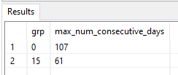
Data gaps and overlaps: max consecutive days
SELECT
grp,
count(*) as max_num_consecutive_days
FROM
"master_class_2021_adv_sql.License_contiguous_dates_grouped"
group by
grp
;;

Slide 16
Data gaps and overlaps: expand all dates
SELECT "invoice_num", "license_start", "license_end" FROM "dwh.tblInvoices";;
row | invoice_num | license_start | license_end
1 | 1 | 2020-06-01 | 2020-07-01
2 | 2 | 2020-07-01 | 2020-07-31
3 | 3 | 2020-08-01 | 2020-08-31
4 | 6 | 2020-09-01 | 2020-09-15
5 | 7 | 2020-10-01 | 2020-10-31
6 | 8 | 2020-10-15 | 2020-11-30
create view master_class_2021_adv_sql.License_dates as
SELECT i.invoice_num, i.license_start, i.license_end, d.xdate
FROM
"dwh.tblInvoices" as i
join "master_class_2021_adv_sql.dateaxis_start_end"(
"startdate" => '2020-06-01',
"enddate" => '2020-11-30'
) as d
on d.xdate between i.license_start and i.license_end
;;

Slide 17
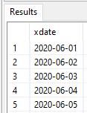
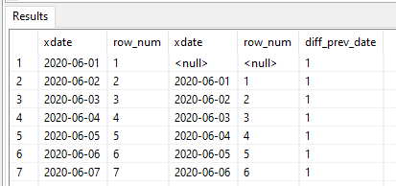
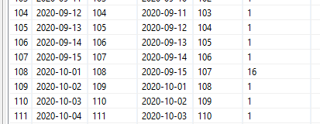
Data gaps and overlaps: grouping dates
SELECT distinct "xdate" FROM "master_class_2021_adv_sql.License_dates";;
with cteDistinctDates as (
SELECT distinct "xdate" FROM "master_class_2021_adv_sql.License_dates"
),
cteNumberesDistinctDates as (
SELECT xdate, row_number() over(order by xdate) as row_num FROM cteDistinctDates
)
select
c1.xdate, c1.row_num, c2.xdate, c2.row_num,
case
when c2.xdate is null then 1
else TIMESTAMPDIFF(SQL_TSI_DAY, c2.xdate, c1.xdate)
end as diff_prev_date
from
cteNumberesDistinctDates c1
left join cteNumberesDistinctDates c2
on c1.row_num = c2.row_num +1
;;

Slide 18
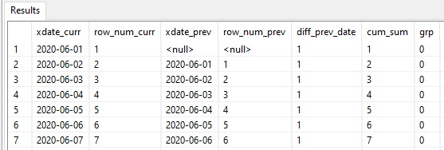
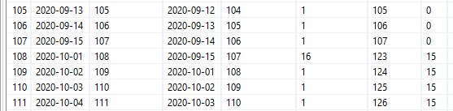
Data gaps and overlaps: grouping dates
create view master_class_2021_adv_sql.License_contiguous_dates_grouped as
with cteDistinctDates as (
SELECT distinct "xdate" FROM "master_class_2021_adv_sql.License_dates"
),
cteNumberedDistinctDates as (
SELECT xdate, row_number() over(order by xdate) as row_num
FROM cteDistinctDates
),
cteDiff as (
select
c1.xdate as xdate_curr, c1.row_num as row_num_curr, c2.xdate as xdate_prev, c2.row_num as row_num_prev,
case
when c2.xdate is null then 1
else TIMESTAMPDIFF(SQL_TSI_DAY, c2.xdate, c1.xdate)
end as diff_prev_date
from
cteNumberedDistinctDates c1
left join cteNumberedDistinctDates c2
on c1.row_num = c2.row_num +1
)
select
cteDiff.*,
sum(cteDiff.diff_prev_date) over(order by cteDiff.row_num_curr rows unbounded preceding) as cum_sum,
sum(cteDiff.diff_prev_date) over(order by cteDiff.row_num_curr rows unbounded preceding) - cteDiff.row_num_curr as grp
from cteDiff
;;

Slide 19
Data gaps and overlaps: max consecutive days
SELECT
grp,
count(*) as max_num_consecutive_days
FROM
"master_class_2021_adv_sql.License_contiguous_dates_grouped"
group by
grp
;;

Slide 20
Using hashes to detect changed records

Slide 21
Hashes for change detection
table
id | col1 | col2 | modified_date
1 | a | d | 2020-08-31
2 | b | e | 2020-09-15
3 | c | f | 2020-10-31
Ideal situation
table
id | col1 | col2
1 | a | d
2 | b | e
3 | c | f

Slide 22
Hashes for change detection
table
table_w_modified_date
id | col1 | col2
1 | a | d
2 | b | e
3 | c | f
Trigger is fired on insert or update
id | modified_date
1 | 2020-08-31
2 | 2020-09-15
3 | 2020-10-31

Slide 23
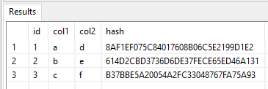
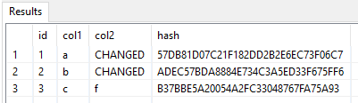
Hashes for change detection
SELECT "id", "col1", "col2", md5(col1 || '~|\/' || col2) as hashkey FROM "master_class_2021_adv_sql.Data_without_modified_date";;
SELECT "id", "col1", "col2", md5(col1 || '~|\/' || col2) as hashkey FROM "master_class_2021_adv_sql.Data_without_modified_date_v2";;

Slide 24
Dynamically create stored procedures

Slide 25
Dynamically create stored procedures
CREATE procedure master_class_2021_adv_sql.ReplacingText(
IN proc_name string not null,
IN metrics STRING NOT NULL,
IN elements STRING NOT NULL
)
returns (sql_code string)
AS
begin
declare string dummy_sproc_template =
'
create procedure master_class_2021_adv_sql.<<proc_name>>(
IN reportId INTEGER NOT NULL
)
RETURNS (
"date" string,
"year" string,
"month" string,
"day" string,
"hour" string,
<<element_columns>>,
<<metric_columns>>
) AS
begin
/* !*!*! Dummy sproc. Will be replaced dynamically. !*!*! */
end
';
declare string proc_sql = (select replace(replace(replace(
dummy_sproc_template, '<<element_columns>>', elements),
'<<metric_columns>>', metrics),
'<<proc_name>>', proc_name)
);
execute (proc_sql) without return;
select proc_sql;
end;
select * from (call "master_class_2021_adv_sql.ReplacingText"(
"proc_name" => 'dummy_sproc',
"metrics" => 'string_metrics string',
"elements" => 'string_elements string'
)) as a;;
create procedure master_class_2021_adv_sql.dummy_sproc(
IN reportId INTEGER NOT NULL
)
RETURNS (
"date" string,
"year" string,
"month" string,
"day" string,
"hour" string,
string_elements string,
string_metrics string
) AS
begin
/* !*!*! Dummy sproc. Will be replaced dynamically. !*!*! */
end
;

Slide 26
Using embedded languages in Data Virtuality

Slide 27
Embedded languages
Create Virtual Procedure "master_class_2021_adv_sql"."RegexReplace" (
IN initialString string not null,
IN regex string not null,
IN replacement string not null
)
Returns (resultString string)
As
Begin
Select
resultString
From
ObjectTable (language 'javascript' '
(new java.lang.String(initialString)).replaceAll(regex, replacement)
'Passing
initialString as initialString,
regex as regex,
replacement as replacement
Columns
resultString string 'dv_row'
) o;
End;;
CREATE view "master_class_2021_adv_sql"."RegexReplaceExample"
as
select
k.Name,
(call demos.RegexReplace(
"initialString" => k.Name,
"regex" => '[aeiouAEIOU]',
"replacement" => '**'
)) as regex_replacement
from
SYS.DataTypes AS k;;

Slide 28
Embedded languages
create view "master_class_2021_adv_sql"."ReverseDataTypeNames" as
SELECT
"k.Name","x.Reversed"
FROM
SYS.DataTypes AS "k",
OBJECTTABLE(
LANGUAGE 'javascript'
'function reverse(s){ return s.split("").reverse().join(""); }
reverse(tabname);'
PASSING "k.Name" AS "tabname"
COLUMNS "Reversed" string 'dv_row'
) AS x;;
create view "master_class_2021_adv_sql"."javascript_example" as
SELECT x.*
FROM ( OBJECTTABLE(
LANGUAGE 'javascript'
'var rows = [];
firstrow = { "col1": "foo", "col2": "bar" };
rows.push( firstrow );
secondrow = { "col2": "foo", "col3": "bar" };
rows.push( secondrow );
rows;'
COLUMNS
"col1" string 'dv_row.col1',
"col2" string 'dv_row.col2',
"col3" string 'dv_row.col3',
"col4" string 'dv_row.col4' ) AS x)

Slide 29
Regular expressions

Slide 30
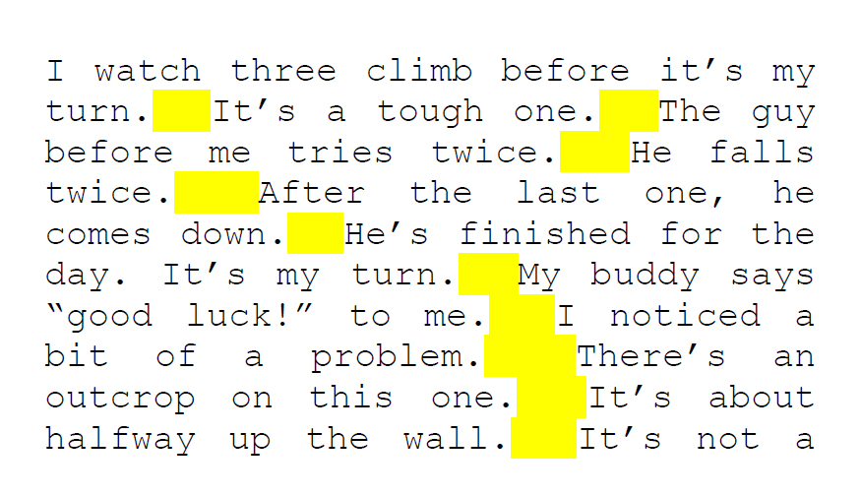
Regular expressions
https://en.wikipedia.org/wiki/Regular_expression
A regular expression (shortened as regex or regexp;^{[1]} also referred to as rational expression^{[2][3]}) is a sequence of characters that specifies a search pattern.
At least two spaces are matched, but only if they occur directly after a period (.) and before an uppercase letter.

Slide 31
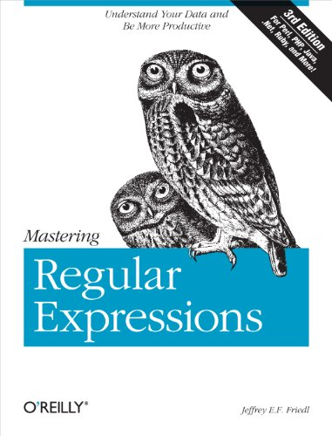
Regular expressions
https://www.amazon.com/dp/B007I8S1X0/ref=dp-kindle-redirect?_encoding=UTF8&btkr=1

Slide 32
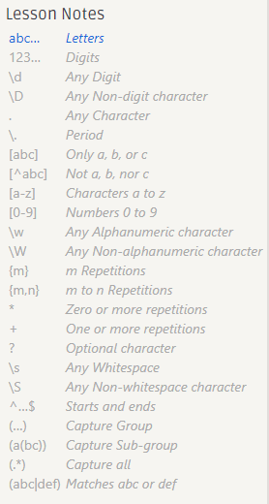
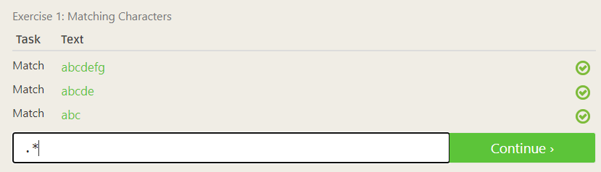
Regular expressions
https://regexone.com/

Slide 33
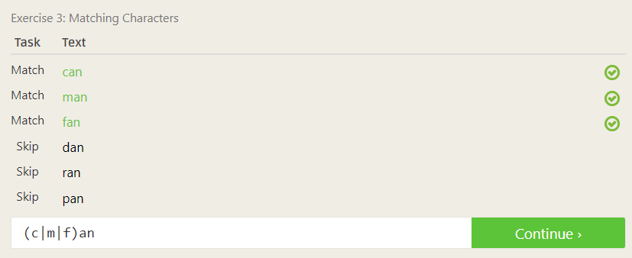
Regular expressions
https://regexone.com/

Slide 34
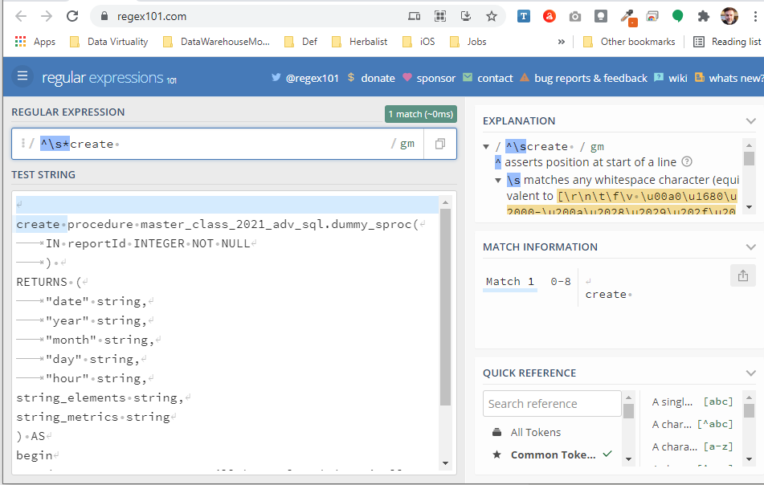
Regular expressions
https://regex101.com/

Slide 35
Regular expressions
create procedure master_class_2021_adv_sql.HowToAlterStoredProcedure()
returns(resultString string) as
begin
declare string proc_def = (select definition FROM "SYSADMIN.ProcDefinitions" where name = 'master_class_2021_adv_sql.dummy_sproc');
select * from (call "master_class_2021_adv_sql.RegexReplace"(
"initialString" => proc_def,
"regex" => '^\s*create ',
"replacement" => 'alter '
)) as a;
end;;
create procedure master_class_2021_adv_sql.dummy_sproc(
IN reportId INTEGER NOT NULL
)
RETURNS (
"date" string,
"year" string,
"month" string,
"day" string,
"hour" string,
string_elements string,
string_metrics string
) AS
begin
/* !*!*! Dummy sproc. Will be replaced dynamically. !*!*! */
end
;
alter procedure master_class_2021_adv_sql.dummy_sproc(
IN reportId INTEGER NOT NULL
)
RETURNS (
"date" string,
"year" string,
"month" string,
"day" string,
"hour" string,
string_elements string,
string_metrics string
) AS
begin
/* !*!*! Dummy sproc. Will be replaced dynamically. !*!*! */
end
;

Slide 36
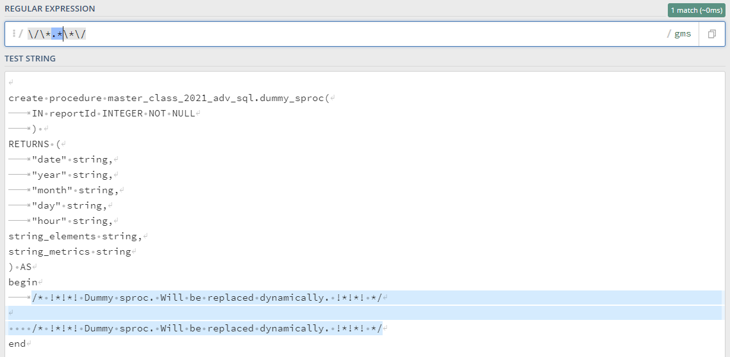
Regular expressions

Slide 37
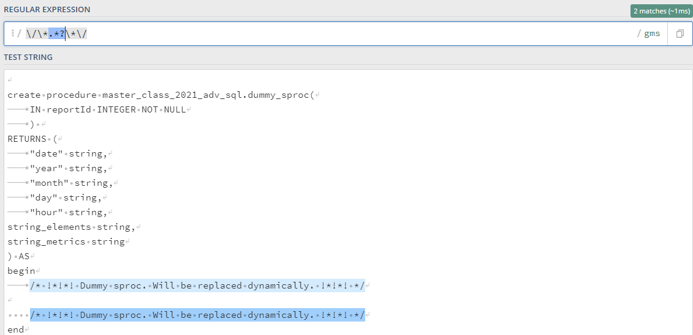
Regular expressions

Slide 38
Any feedback / questions?

Slide 39
Thank you!
Please feel free to contact us at:
info@datavirtuality.com
or
visit us at:
datavirtuality.com

